Slide 1
Course Info
Time: TR 11:10-12:25 AM
M 3:00-3:50 PM
Location: CHEN 106
Instructor: Dr. Martin Sentmanat
Office: CHEN 248
Phone: (979) 862-7687
Email: martin.sentmant@tamu.edu
Office Hours
M 10:00-11:00 AM
W 1:00-3:00 PM
Category | Date | Percentage
Homework | N/A | 10%
Daily Quizzes | N/A | 10%
Midterm 1 | Sep 26th | 25%
Midterm 2 | Nov 5th | 25%
Final | Dec 6th 8:00-10:00 | 30%

Slide 2
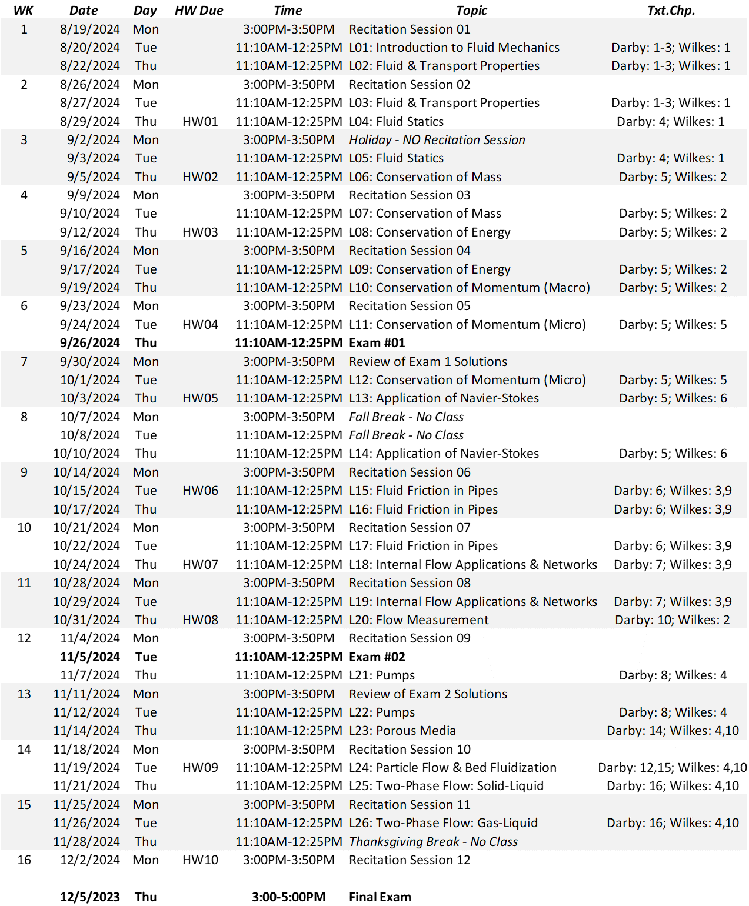

Slide 3
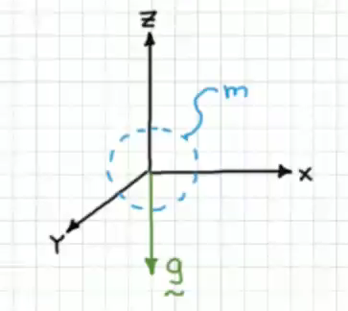
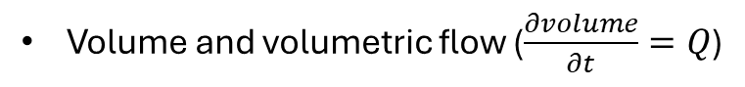
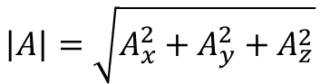
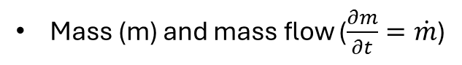
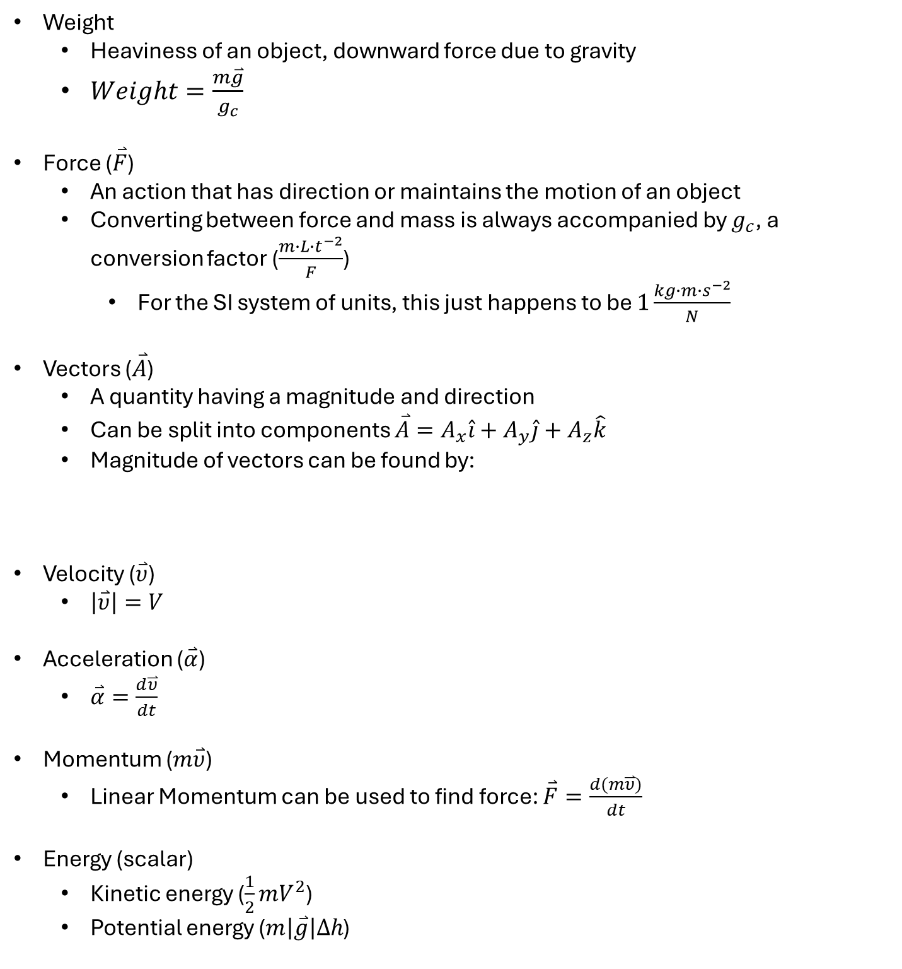
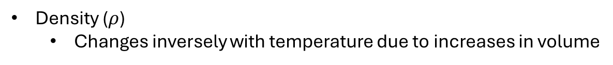
Review
Mass (m) and mass flow ($\frac{∂m}{∂t}=\dot{m}$)
Volume and volumetric flow ($\frac{∂volume}{∂t}=Q$)
In this course, Q is volumetric flow, not heat
Density ($ρ$)
Changes inversely with temperature due to increases in volume
Weight
Heaviness of an object, downward force due to gravity
$Weight=\frac{m\overset{⃑}{g}}{g_{c}}$
Force ($\overset{⃑}{F}$)
An action that has direction or maintains the motion of an object
Converting between force and mass is always accompanied by $g_{c}$, a conversion factor ($\frac{m∙L{∙t}^{−2}}{F}$)
For the SI system of units, this just happens to be $1\frac{kg∙m∙s^{−2}}{N}$
Vectors ($\overset{⃑}{A}$)
A quantity having a magnitude and direction
Can be split into components $\overset{⃑}{A}=A_{x}\hat{i}+A_{y}\hat{j}+A_{z}\hat{k}$
Magnitude of vectors can be found by:
Velocity ($\overset{⃑}{υ}$)
$\left|\overset{⃑}{υ}\right|=V$
Acceleration ($\overset{⃑}{α}$)
$\overset{⃑}{α}=\frac{d\overset{⃑}{υ}}{dt}$
Momentum ($m\overset{⃑}{υ}$)
Linear Momentum can be used to find force: $\overset{⃑}{F}=\frac{d(m\overset{⃑}{υ})}{dt}$
Energy (scalar)
Kinetic energy ($\frac{1}{2}mV^{2}$)
Potential energy ($m\left|\overset{⃑}{g}\right|Δh$)
$$\left|A\right|=\sqrt{A_{x}^{2}+A_{y}^{2}+A_{z}^{2}}$$

Slide 4
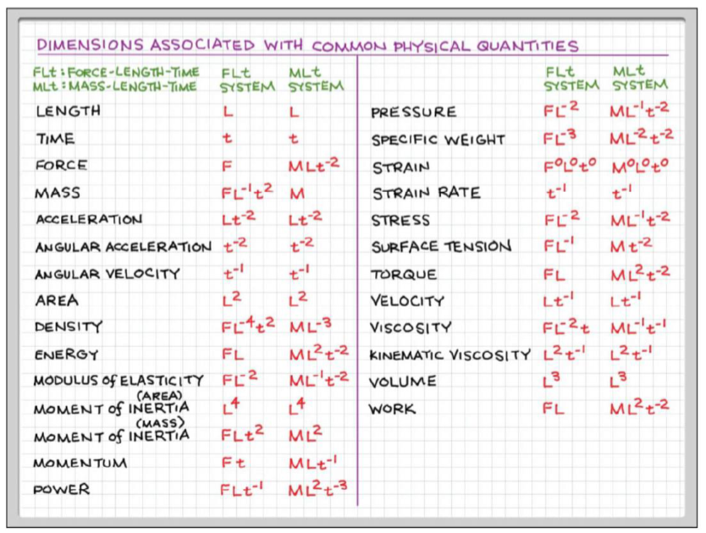
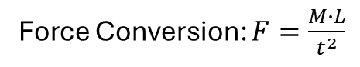
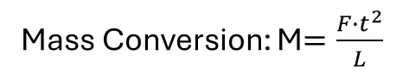
Introduction
What is a fluid?
You can classify something as a fluid or non-fluid based on how it reacts to a shear force (A force acting parallel to the surface)
Non-fluids can resist shear forces (solids)
Fluids deform under a shear force (liquids and gases)
States of Matter
Solids: have a lattice structure that holds them together, making them not deform
Liquids: held together by weaker forces, the forces are dependent on the separation distance of the molecules
Gases: spread far apart and have very weak interactions
Molecules collide with each other
Will not tend to fall when “poured” out of a cup
Modulus of elasticity tells how stiff something is
Kinematic viscosity is viscosity normalized by density (viscosity/density)
Force Conversion: $F=\frac{M∙L}{t^{2}}$
Mass Conversion: M$=\frac{F∙t^{2}}{L}$

Slide 5
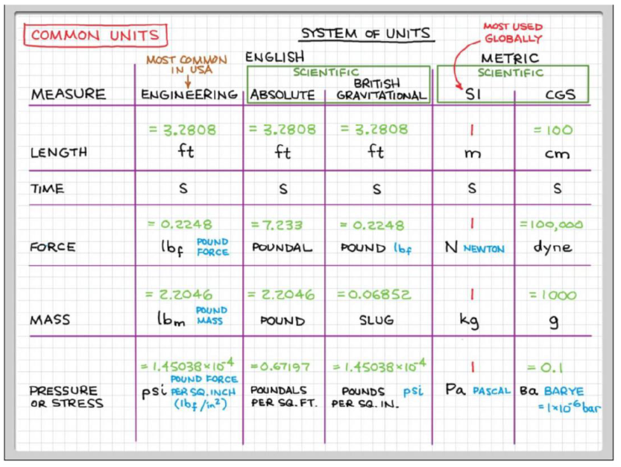
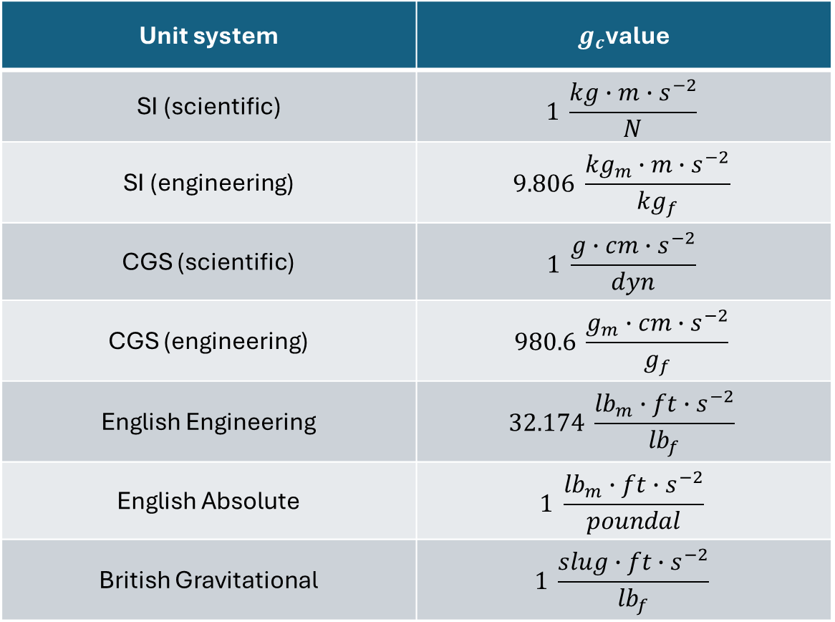
Some other common units are $g_{f}$ and ${kg}_{f}$, which are units of force that are normalized so that the weight of 1 kg is 1 ${kg}_{f}$
Unit system | $g_{c}$value
SI (scientific) | $$1 \frac{kg∙m∙s^{−2}}{N}$$
SI (engineering) | $$9.806 \frac{{kg}_{m}∙m∙s^{−2}}{{kg}_{f}}$$
CGS (scientific) | $$1 \frac{g∙cm∙s^{−2}}{dyn}$$
CGS (engineering) | $$980.6 \frac{g_{m}∙cm∙s^{−2}}{g_{f}}$$
English Engineering | $$32.174 \frac{{lb}_{m}∙ft∙s^{−2}}{{lb}_{f}}$$
English Absolute | $$1 \frac{{lb}_{m}∙ft∙s^{−2}}{poundal}$$
British Gravitational | $$1 \frac{slug∙ft∙s^{−2}}{{lb}_{f}}$$

Slide 6
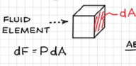
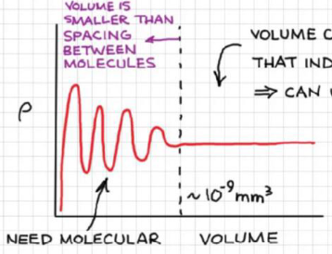
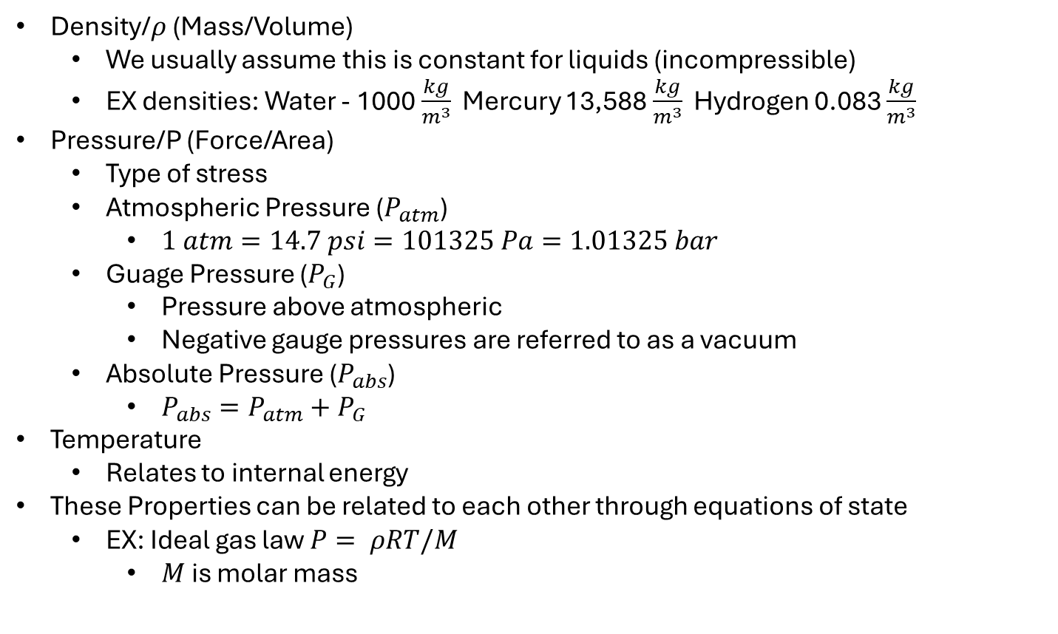
Basic Laws of Fluid Flows
Conservation of Mass
Conservation of Energy – 1st Thermo
Conservation of Momentum – 2nd Newton
Fluid Properties
Density/$ρ$ (Mass/Volume)
We usually assume this is constant for liquids (incompressible)
EX densities: Water - 1000 $\frac{kg}{m^{3}}$ Mercury 13,588 $\frac{kg}{m^{3}}$ Hydrogen 0.083 $\frac{kg}{m^{3}}$
Pressure/P (Force/Area)
Type of stress
Atmospheric Pressure ($P_{atm}$)
$1 atm=14.7 psi=101325 Pa=1.01325 bar$
Guage Pressure ($P_{G}$)
Pressure above atmospheric
Negative gauge pressures are referred to as a vacuum
Absolute Pressure ($P_{abs}$)
$P_{abs}=P_{atm}+P_{G}$
Temperature
Relates to internal energy
These Properties can be related to each other through equations of state
EX: Ideal gas law $P= ρRT/M$
$M$ is molar mass
Continuum Assumption
Fluid molecules aren’t confined to a lattice, and move around, so how do we deal with a volume in which the number of particles is constantly changing?
Only at extremely small sizes this makes a difference, so we can assume that values vary continuously through space (Continuum)
Material Classification
Materials can be classified based on how they respond to a shear force
In this class, we will only be focusing on Newtonian and Non-Newtonian fluids
Newtonian fluids have a constant viscosity, while Non-Newtonian fluids have viscosities that change

Slide 7
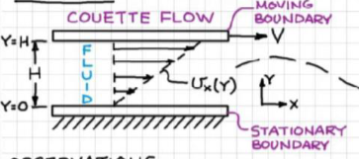
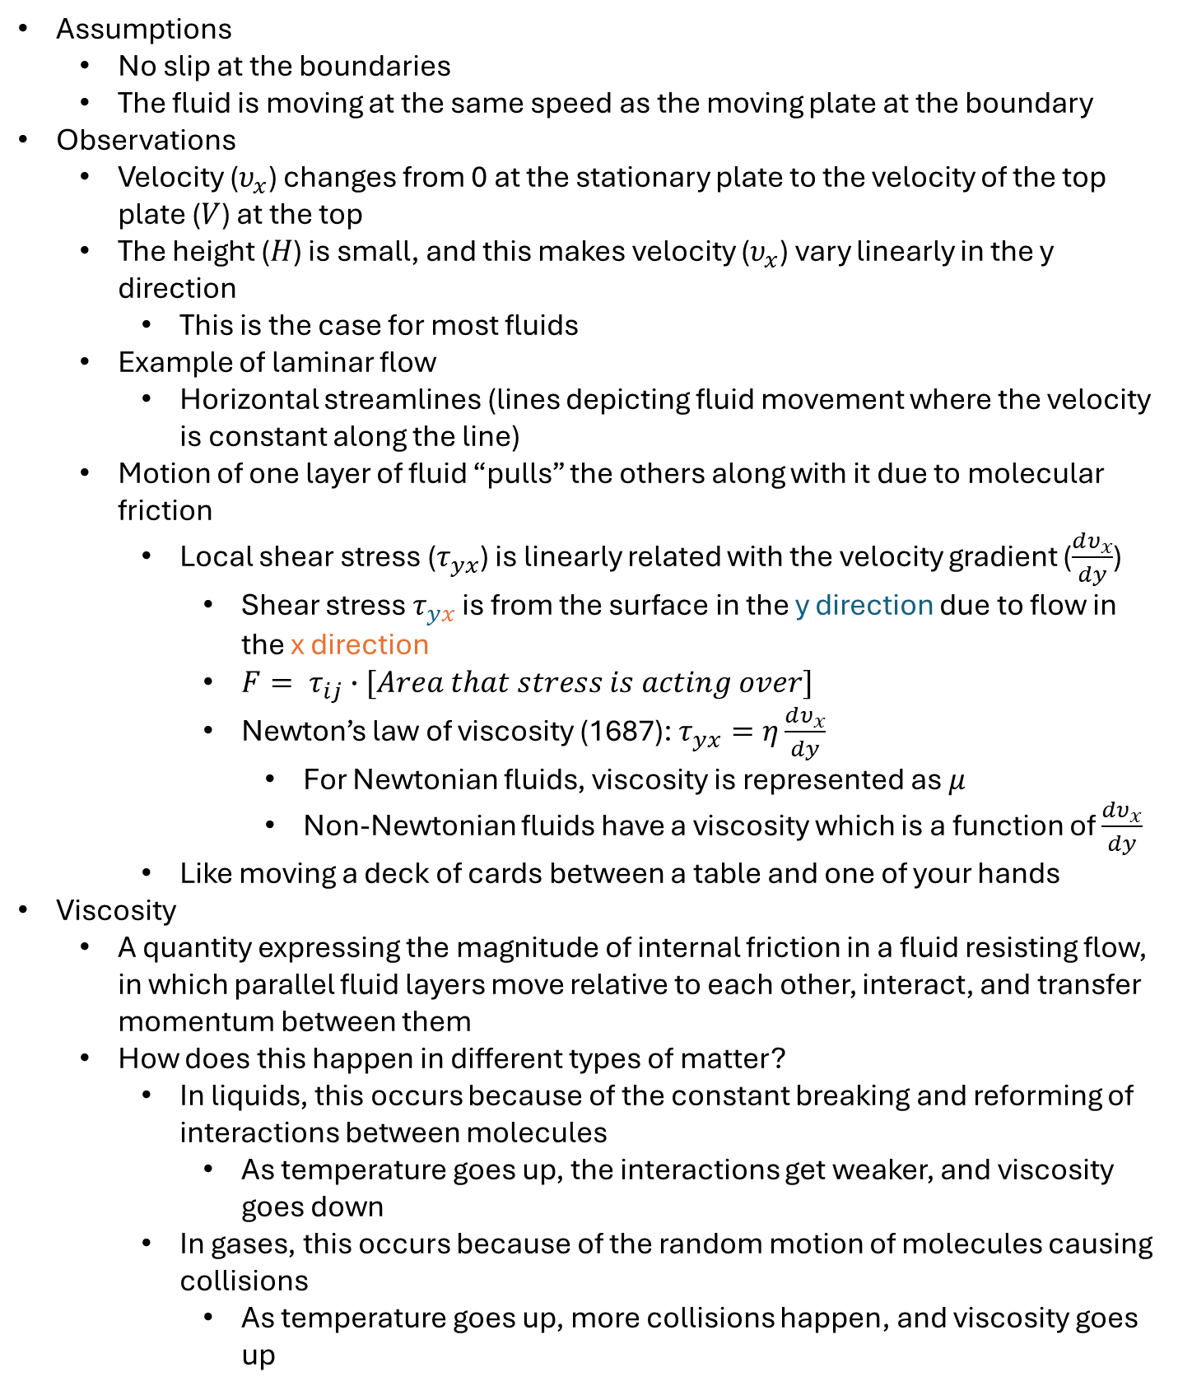
Transport Properties
Viscosity – resistance to flow
Couette Flow (drag flow)
Liquid between and stationary and moving plate in which flow is being caused by the moving plate
Assumptions
No slip at the boundaries
The fluid is moving at the same speed as the moving plate at the boundary
Observations
Velocity ($υ_{x}$) changes from 0 at the stationary plate to the velocity of the top plate ($V$) at the top
The height ($H$) is small, and this makes velocity ($υ_{x}$) vary linearly in the y direction
This is the case for most fluids
Example of laminar flow
Horizontal streamlines (lines depicting fluid movement where the velocity is constant along the line)
Motion of one layer of fluid “pulls” the others along with it due to molecular friction
Local shear stress ($τ_{yx}$) is linearly related with the velocity gradient ($\frac{dυ_{x}}{dy}$)
Shear stress $τ_{yx}$ is from the surface in the y direction due to flow in the x direction
$F= τ_{ij}∙[Area that stress is acting over]$
Newton’s law of viscosity (1687): $τ_{yx}=η\frac{dυ_{x}}{dy}$
For Newtonian fluids, viscosity is represented as $μ$
Non-Newtonian fluids have a viscosity which is a function of $\frac{dυ_{x}}{dy}$
Like moving a deck of cards between a table and one of your hands
Viscosity
A quantity expressing the magnitude of internal friction in a fluid resisting flow, in which parallel fluid layers move relative to each other, interact, and transfer momentum between them
How does this happen in different types of matter?
In liquids, this occurs because of the constant breaking and reforming of interactions between molecules
As temperature goes up, the interactions get weaker, and viscosity goes down
In gases, this occurs because of the random motion of molecules causing collisions
As temperature goes up, more collisions happen, and viscosity goes up

Slide 8
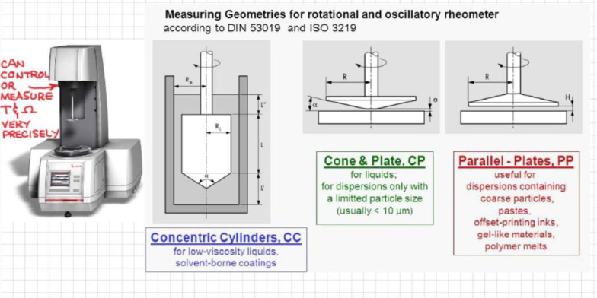
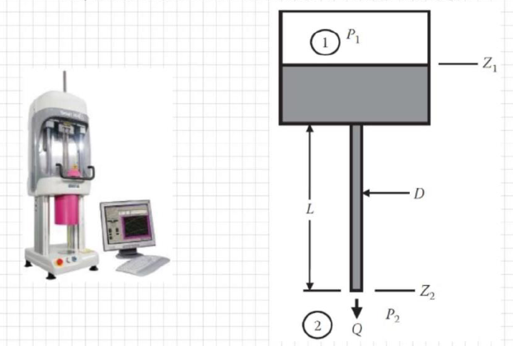
How is viscosity measured?
By how it responds to a simple deformation, where only one component of velocity is non-zero
Most often this is in the form of simple shear flow
The two types of simple shear flow are Couette flow and Poiseuille flow (pressure driven through a pipe)
Using Couette flow (Rotational viscometer/rheometer)
Fluid trapped between stationary rotating surfaces
Torque related to the viscosity of the fluid
Using Poiseuille Flow (Capillary viscometer/rheometer)
Fluid forced through a circular tube
Pressure related to viscosity

Slide 9
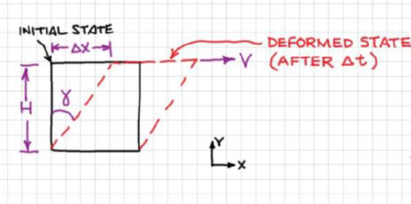

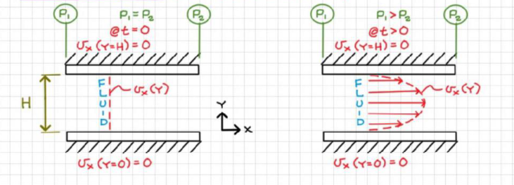
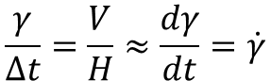
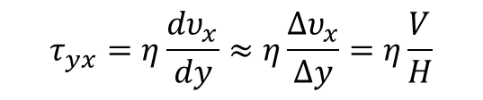
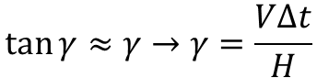
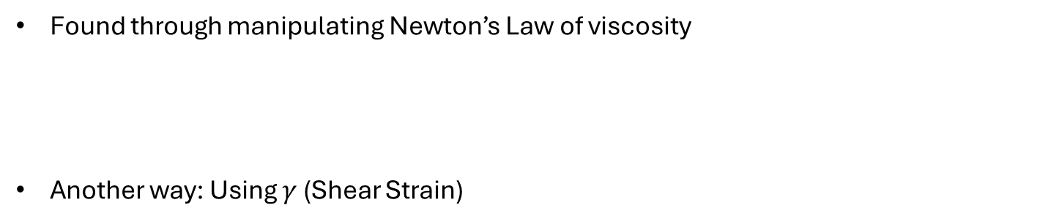
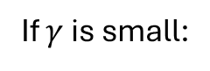
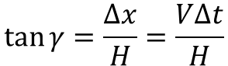
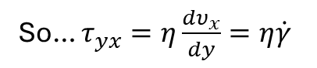
Finding Shear Stress
Found through manipulating Newton’s Law of viscosity
Another way: Using $γ$ (Shear Strain)
At the point where the fluid is in contact with the moving plate
$$τ_{yx}=η\frac{dυ_{x}}{dy}≈η\frac{∆υ_{x}}{∆y}=η\frac{V}{H}$$
$$\tan{γ}=\frac{∆x}{H}=\frac{V∆t}{H}$$
If $γ$ is small:
$$\tan{γ}≈γ→γ=\frac{V∆t}{H}$$
$$\frac{γ}{∆t}=\frac{V}{H}≈\frac{dγ}{dt}=\dot{γ}$$
So… $τ_{yx}=η\frac{dυ_{x}}{dy}=η\dot{γ}$
Often called the Shear Rate
Poiseuille Flow (pressure-driven flow)
(Quick detour)
No moving plates
Velocities at the plates are still 0 because of the no-slip assumption
Instead of a linear velocity gradient, it is parabolic

Slide 10
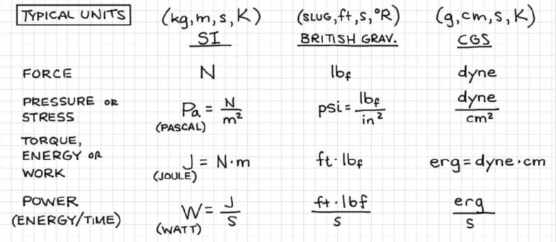
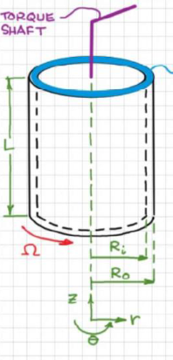
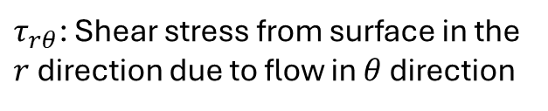
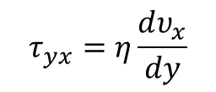
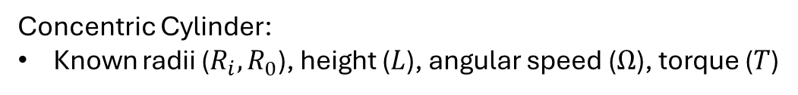
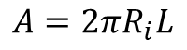
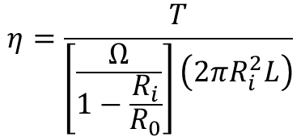
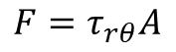
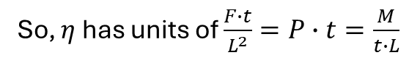
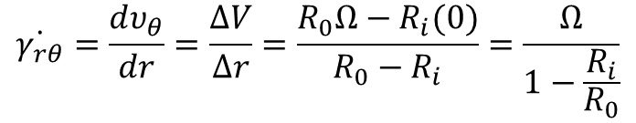
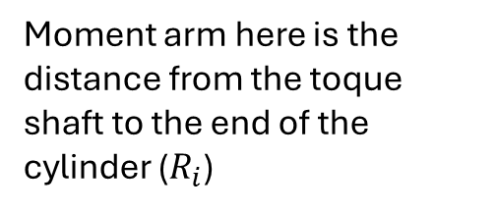
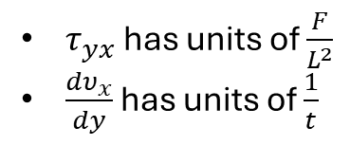
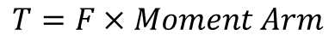
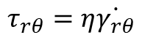
More Units
Determining Units for Viscosity using Newton’s Law of viscosity :
$$τ_{yx}=η\frac{dυ_{x}}{dy}$$
$τ_{yx}$ has units of $\frac{F}{L^{2}}$
$\frac{dυ_{x}}{dy}$ has units of $\frac{1}{t}$
So, $η$ has units of $\frac{F∙t}{L^{2}}=P∙t=\frac{M}{t∙L}$
Determining viscosity with Viscometers
Concentric Cylinder:
Known radii ($R_{i},R_{0}$), height ($L$), angular speed ($Ω$), torque ($T$)
Moment arm here is the distance from the toque shaft to the end of the cylinder ($R_{i}$)
$$T=F×Moment Arm$$
$$F=τ_{rθ}A$$
$τ_{rθ}$: Shear stress from surface in the $r$ direction due to flow in $θ$ direction
$$A=2πR_{i}L$$
$$τ_{rθ}=η\dot{γ_{rθ}}$$
$$\dot{γ_{rθ}}=\frac{dυ_{θ}}{dr}=\frac{ΔV}{Δr}=\frac{R_{0}Ω−R_{i}(0)}{R_{0}−R_{i}}=\frac{Ω}{1−\frac{R_{i}}{R_{0}}}$$
Substituting and rearranging…
$$η=\frac{T}{\left[\frac{Ω}{1−\frac{R_{i}}{R_{0}}}\right]\left(2πR_{i}^{2}L\right)}$$
Remember: only valid for small gaps

Slide 11
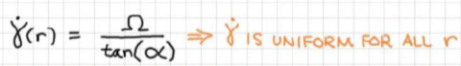
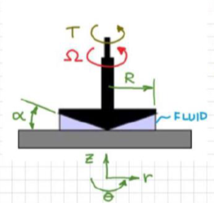
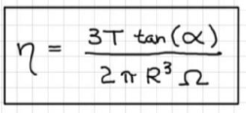
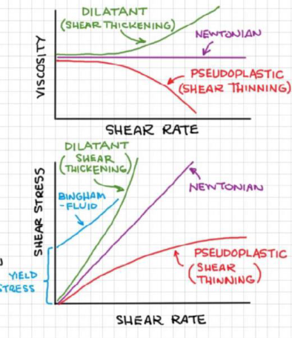
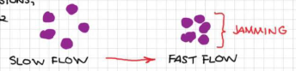

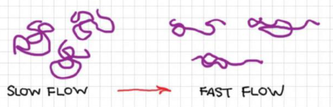
Cone and Plate (More commonly used)
So, the shear rate is uniform throughout the fluid
Alpha is usually smaller than $2^{o}$. Usually around $1^{o}$
Viscosity for Non-Newtonian Fluids
Instead of having a constant viscosity, non-Newtonian fluids’ viscosity is a function of shear rate
Bingham fluid:
Only flows when a yield stress is exceeded
Toothpaste, ketchup
Dilatant (Shear Thickening)
Fluid contains components that can’t deform or rearrange to accommodate flow
Corn starch and water mixture
Pseudoplastic (Shear Thinning)
Fluid contains components that can deform and rearrange to accommodate flow
Micelles, blood

Slide 12
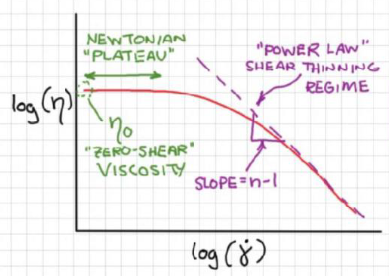
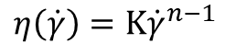




Power Law Model
A way to determine the viscosity of shear thinning materials at high shear rates
This is only valid at high shear rates
$$η\left(\dot{γ}\right)=Κ{\dot{γ}}^{n−1}$$
$Κ$ = Consistency index
$n$ = Power law index
For many fluids, $n$ is around 0.5.
(1 for Newtonian fluids)
$$\log{η}=\log\left(Κ\right)+\left(n−1\right)\log\left(\dot{γ}\right)$$
Y intercept
Slope
What are $Κ$ and $n$?
Consistency index serves to reflect the magnitude of $η$
Power law index serves to reflect the degree of shear thinning
Units:
Since one is dimensionless, n is also dimensionless
K has units of Pressure * time ^ n

Slide 13





Fluid Statics
When at rest, there is no shear stress, because there is no deformation, but there is pressure
Properties of Pressure
Acts normal to the surface and goes inward, towards the body
Pressure gradients produce a net force on submerged bodies
Problems we are interested in when fluids are at rest
Forces on submerged and floating bodies
Pressure distribution in atmosphere and oceans
Measurements of fluid properties (density and pressure)
Observations for a uniform static fluid
Pressure changes only in the vertical direction and increases with depth
Pressure is independent of the shape of the container
Pressure is the same at all points in a horizontal plane
Quantifying how pressure changes with depth ($\frac{∂P}{∂z}$)
In the Y direction
The pressure at the point plus the pressure gradient times the distance from the point
This will equal zero, and same with the x direction
Z direction
Now we must account for a weight term

Slide 14










Because Pressure only changes in the z direction, we can turn that partial derivative into a normal derivative and solve for P
Now, if we consider a pressure difference to make a definite integral:
$$P_{2}−P_{1}=−ρg(z_{2}−z_{1})$$
We get the Hydrostatic equation
The hydrostatic equation can also be written in terms of the potential ($φ_{i}$)
The potentials at all points in the same fluid are equal
$$φ_{i}=P_{i}+ρgz_{i}$$
Remember, these equations are valid for fluids at rest
Manometer
Any two points at the same height and in the same fluid are at the same hydrostatic pressure
Since $z^{∗}$ and $z^{1}$ are at the same height and in the same volume, the pressures at both locations are equal
For Manometers, the fluids are assumed to be incompressible and immiscible

Slide 15





Relative Density
$$Relative Density= \frac{ρ_{substance}}{ρ_{reference}}$$
For simplicity, $ρ_{reference}$ is water at 4º Celsius

Slide 16







Other Types of Pressure Measurement Devices
Bourdon Tube
Most common analog device for measuring pressure
Consists of a bent hollow tube whose end is connected to a dial needle mechanism
When the fluid in the tube increases in pressure, the tube stretches and moves the dial
Can accurately measure up to 100,000 psi
The main problem with it is that it can’t connect to computers
Pressure Transducer
Converts effects from pressure into electrical effects so the information can be transferred to a computer
Contains a flexible membrane on a metal that is deformed with the metal due to pressure changes. The membrane contains a circuit whose resistance changes when the membrane bends
Very precise; can read up to 1 millionth of an atmosphere
Strain gauge is the most common
Buoyancy
Archimedes of Syracuse (287-212 BC)
Greek mathematician who proposed that “any object, totally or partially immersed in a fluid or liquid, is buoyed up by a force equal to the weight of the fluid displaced by the object” in his “On Floating Bodies” in 250BC
Also derived the area of a circle, volume of a sphere and area under a parabola

Slide 17











Expression of $F_{b}$ for a cylinder
Applying the hydrostatic equation:
The buoyant force can be written as
Zero because it’s relative
Volume of displaced fluid
If we have a floating object:
By measuring the depth of immersion, we can calculate the density ratio or specific gravity.
(How a hydrometer works)
Buoyancy problems can be approached in this manner:

Slide 18












Surface Tension
Work needed to change interfacial area
Since we already used $γ$ for shear stress, we will use $γ_{T}$ for surface tension
When surface tension is positive, it takes work to increase surface area
Young-Laplace Equation
This is why small insects can skim on water
dydx can be neglected because they are both very small
Ratio between two proportional triangles

Slide 19






How is surface tension measured? – Capillary rise method

Slide 20









Conservation of Mass
In this class, X will be mass, energy, or momentum
Conservation of Mass
Describing inflow and outflow of mass
$\overset{⃑}{n}$ is the normal vector facing outward
$\overset{⃑}{υ}$ is the velocity of the flow going through the area
Combined, these make a height

Slide 21






Volume * density
Now, lets write the law for conservation of mass. This is like the derivation of the hydrostatic equation
Need the partial differentials, because you need to take into consideration how the flux changes through the object

Slide 22





Continuing, but now for all directions
Making the generalized continuity equation, which can be used for all coordinate systems
For incompressible fluids, the second term is 0

Slide 23






Not Gases in turbulent flow
Getting the continuity equation in the form of linear flow

Slide 24



What if your velocity is not uniform?
Use this for V. If you are trying to find Q (like in many mass balances), Just use Vavg * A
Ok, but now what if your velocity isn’t uniform, and you’re dealing with a circular pipe?
Some tips for mass balance Problems:
Always start with your mass balance (Min – Mout = Macc)
If your system is in steady state, Macc is 0
If your flow is incompressible, your system simplifies to a volume balance
(because M = density * Q and all your densities are the same) 4. You will likely need to integrate some Volume or Mass terms to find an answer

Slide 25






Conservation of Energy
Basic energy balance follows this equation
We can make a few assumptions to simplify this
This make all but the mass terms go to 0
Now we can write it in terms of mass rate

Slide 26






No Accumulation
And, if we assume incompressible fluid and negligible change in temperature
Remember it is delta (V²)
Not (delta V)²

Slide 27


Side Note: His Dad was jealous his son was as smart or smarter than him, so Bernoulli’s dad framed him for plagiarizing his work after Hydrodynamica came out. (his father was found out)
Pitot Tube – Flow measurement device

Slide 28














Zs are 0 and velocity at point 2 is 0
Another Pitot Tube Example

Slide 29




Impact + Static Tubes
A more modern way of finding flow velocity for flow in pipes and for gasses is through a pitot tube with a static tube
It combines the pitot tube with a way to find the static pressure, so it can be used in pipes
The separate pipes are connected to pressure transducers, so they are known
It lends itself well to being used with Bernoulli's idealized equation, because it is stationed away from the walls
Some other ways to measure flow velocity

Slide 30











Guide for solving energy balance problems
Always start with a mass balance. This is useful for dealing with multiple unknown velocity terms. The proportions of the velocities can be found with the mass balance and substituted into the energy balance.
Remember when Bernoulli’s equation is valid
Steady State
Incompressible fluid
Inviscid flow
Bulk flow, away from walls
Just a reminder, but densities of gases are so small. So, for regular sized columns, the pressures at the top and bottom of these columns have a negligible change
Torricelli’s theorem
We want to find the exit velocity of a fluid coming out of a hole at the bottom of a column of water
Mass balance yields
Energy balance
If D2 is much smaller than D1, we can make this simplification
When Bernoulli’s Idealized equation goes too far – trying to find out how long this tank will take to empty
Mass balance
This equation is bad because it doesn’t consider species specific qualities

Slide 31




Conservation of Momentum
Macroscopic
To make our conservation equation, we look to Newton’s 2nd
Our General conservation of momentum formula

Slide 32














Let's look at an example of fluid flow through a curved pipe
Assumptions:
Steady state, incompressible
Why no gravity? We aren’t given volume details and wouldn’t be able to know mass of the fluid in the pipe. We would also need to know mass of the pipe itself
Just trying to display effect of momentum on the system
Now for a nozzle example
No need for Cons. of mass because no mass flow
Guage pressure is useful because the absolute pressure on the left side is counteracted by the atmospheric pressure on the other side

Slide 33




Now, what if we open the valve?
Assumptions: SS and incompressible
Well, since we are dealing with flows, let’s start with cons. of mass
To find the sum of the forces, we need to find the velocities. Let’s go to cons. of energy
Note: All flows going out into the world are at atmospheric pressure
Now we have everything to solve for the force on the nozzle

Slide 34




What if our flows are going in not the same direction?
Notice how on either side, the atmospheric pressures cancel with each other, leaving only the gauge pressures. This is why gauge pressure is so useful in pipes

Slide 35


Conservation of Momentum
Microscopic
Before we create our equation, we need to understand how to describe all the forces acting on an element of fluid
Since Forces can act on 3 directions in 3 different forces, we need a 3x3 matrix to describe them. This is called a Tensor

Slide 36






Now, let’s make an equation for the sum of the forces on a body of fluid
Now we need to make expressions for the momentum flow into a system and out of a system

Slide 37



By using momentum flux through a surface and multiplying by the area of the surface, we can get momentum flow
For incompressible flow, this can be written as
Now, take the derivatives of the velocity terms to get
The generalized continuity equation
What about accumulation term?
The u in the velocity term is just for the x direction, it will change based on which axis you are doing your momentum balance on
Ignore the cancellation of the volume term for now

Slide 38





Combining everything together (x-component)
Ok. This is cool, but we need ways to solve for the shear and normal stresses
For Shear Stresses

Slide 39




And for normal stresses
The bulk viscosity term relates mechanical pressure to thermodynamic pressure
For us, the bulk viscosity term goes to 0 because we are dealing with an incompressible fluids
Now, if we substitute the normal and shear forces into the Cauchy Momentum Equations
We get the Navier-Stokes equations
Assumptions for these equations: Incompressible, Newtonian fluid
The capital D derivative is called the substantial Derivative

Slide 40





Scaling Navier Stokes Equations
Good for applying Navier-Stokes on a large scale
Makes the equation a dimensionless form where we can find solutions that are independent of specific parameters
Substituting…
Reynolds Number
A ratio of the Inertial forces over the viscous forces
When Re << 1, viscous forces are dominant
Applicable under viscous fluids (honey), low velocities, or small scales
Called creeping flow or stokes flow
When Re >> 1, inertial term is dominant
Applicable under very low viscosities, high velocities, or large scales
Called inviscid flow or bulk flow
(B is half the distance)

Slide 41





Slide 42







Converting to Cylindrical Coordinates
For fluid flow in Pipes
Finding relations between cartesian velocities and cylindrical coordinates
1/r is to make the equation dimensionally consistent

Slide 43



Expressions for the continuity equation in cartesian and cylindrical coordinates
For steady state and incompressible flow
Using cylindrical coordinates for the Navier-Stokes equation

Slide 44



Applying Navier-Stokes for Newtonian Flows
Reminder of shear stress tensors
Stress tensors in cylindrical coordinates
Reminder of continuity equation

Slide 45




Now, these questions are weird and not easily solvable on their own, but they can be heavily simplified if you know your system well
There will be 2 boundary conditions because the equations are 2nd order
Example:
Remember, Navier-Stokes is only applicable for Newtonian and incompressible fluids

Slide 46




Because Pressure is only a function of z and vz is only a function of r, that means the second differential of vz is constant and the 1st derivative of pressure is a constant too

Slide 47





Since delta P is measured from point one to two, we like to define that

Slide 48



Now that answer is great and all, but for very long pipes, the pressure gradient usually isn’t linear, because the extremely high pressures required tend to lead to fluids being compressed, so commonly, you will see this equation instead
Good for laminar flows

Slide 49





What is the max shear stress in the pipe? And where?
Our shear stress
Shear wall stress
Max stress at the wall, minimum stress at the center of the flow
Example 2: rectangular flow

Slide 50




Flow in Pipes: Turbulence, Friction, and Losses
While Navier-Stokes is great, having non-ode equations are much preferable. Especially for turbulent flows (Re > 2000)
for laminar flows, this can last up to 100 times the diameter
For turbulent flows, the velocity profile is much blunter than the laminar flow,
The velocity of turbulent flows is commonly modeled with a power law relationship
The goal is to fix the idealized Bernoulli equation to account for realistic velocity profiles and take viscous losses into consideration

Slide 51










Fixing Velocity Profiles
Velocity
profile
Mass flow
Kinetic energy correction factor:
Takes the shape of the profile into account
Different for different types of flow
Assuming incompressible and simplifying the last term to A * Vavg
Special Cases for the Kinetic energy correction factor
Uniform flow over cross section
Laminar flow in pipe
Turbulent Pipe flow

Slide 52








Incorporating viscous losses
Let’s remake our Bernoulli's equation using macroscopic momentum
Assume steady state and one outlet
Simplifying flow stream momentum terms
Accounting for the forces
Pressures
Gravity
However, instead of putting our gravity in terms of x, we want it in height

Slide 53





Wall Drag
Shaft Work
Opposite of thermo

Slide 54








How do we simplify the viscous losses term?
Now define another term – The loss coefficient
Note: We are looking for low loss coefficients
Fanning Friction Factor

Slide 55



Note: Other engineers use the (bad) Darcy Friction Factor,
Which is 4 times the Fanning friction factor. When reading
Charts, make sure you are aware of which one you are
Dealing with

Slide 56







Looking up some variables
Getting friction factor with turbulent flow
This is important because turbulent flow is most common in pipes,
But it is more challenging to get. Also, a high dependence on pipe roughness

Slide 57

Pipe roughness chart
The 0.3mm should be 0.381 (the values were converted to mm from inches and truncated)

Slide 58



Pipe Schedule
A term used to describe the thickness of a pipe
For a given NPS (nominal pipe size) the OD (outside diameter) of a pipe is the same for all schedules
Schedule 40 is the most common
Higher the schedule, higher the price, thicker the walls, smaller the inside diameter
Pg is the internal working gauge pressure in psi or psig
S is the allowable stress in psi for the material the pipe is made of

Slide 59



Slide 60





Explicit form for the friction factor over the entire range of Reynolds numbers
Non-Newtonian flow (won’t be tested on this but hey, it’s here)
Specifically for power-law behaving fluids (shear thinning at high shear rates)

Slide 61





Other ways to write the modified Bernoulli’s equation
Expressing in terms of power
Original Bernoulli’s equation is represented in energy per unit mass, so multiplying by mass flow rate will give it in terms of power
Also, here’s an equation for civil engineers

Slide 62




Solving Bernoulli’s equation problems
Density, viscosity, and pipe roughness are gotten from tables
+ =
Remember to record your pump work in -Ws, not Ws

Slide 63


Slide 64



Slide 65



Slide 66





Minor Losses
Recall Loss Coefficient, K

Slide 67



Slide 68


Slide 69



Some Fitting Examples

Slide 70





Slide 71




Slide 72





Slide 73



Slide 74




Flow Measurement and Pumps
Increasing Frictional Losses
Pitot/Static-Pitot Tube
Venturi Flow Meter
Nozzle Flow Meter
Orifice Flow Meter
Cheap but inaccurate at low flow rates
Pitot Tube calculations
Venturi and Nozzle meters
Taps are where pressure meters are placed

Slide 75






Slide 76





Orifice Meter

Slide 77


Pressure Tap Locations for Orifice Meter
Cool Image (doesn’t really need to be here)

Slide 78



Slide 79


Slide 80




Slide 81


PUMPS

Slide 82



Point C is the smallest area between impeller and volute casing, so highest velocity
Negative pressure sucks in flow
Increasing Area decreases velocity and increases pressure

Slide 83






As seen from the previous page, velocity remains constant
No noticeable change in height in the pump
No losses in pump, those are accounted for in the pump efficiency

Slide 84






Slide 85





(Entrance to pump)
The Net Positive Suction Head is gotten from pump curves

Slide 86



The first number on the curve labels is the nominal diameter
Pump Performance Chart
The BHPs are for water. If you want to find BHP for anything other than water, use this equation found previously

Slide 87




Pump Selection Problems
Selecting Pump: Like unknown driving force problem with minor losses
Find pump head
Use pump performance chart to select your impeller diameter
Calculating maximum suction
Use the hmax equation to find the maximum height your pump can suck from without cavitation
When solving for major losses, the L will be assumed to be the hmax, meaning you will have to rearrange to solve for it
Net positive suction head is gotten from the pump performance chart

Slide 88


The 2 parallel pump curve line is just doubled the flowrate of the 1 pump curve

Slide 89




Flow in Porous Media
New Variable: Porosity Factor
Fraction of flow medium that is porous

Slide 90





Finding variables used in pipe flow problems for porous problems
Hydraulic Diameter
as is the aspect ratio of the particles in terms of surface area/volume. To find diameter for the non-spherical particles, use this formula

Slide 91


Porous Medium Reynolds Number
Porous Medium Friction Factor
L is the distance through the porous media

Slide 92



Slide 93



Slide 94



To find how long it takes to form a filtered cake, we can substitute variables in for Q
To find the desired cake length

Slide 95




Particle Flows
This is what Aerospace engineers deal with

Slide 96


So, stokes flow is not very useful for many purposes

Slide 97




Drag Coefficient in non-stokes flow

Slide 98




Slide 99



Fluidization

Slide 100


Remember, superficial velocity is the velocity if there were no particles present

Slide 101






Multi-Phase Flows

Slide 102



Slide 103


We want to use the maximum velocity possible without damaging the pipes

Slide 104


Since flow is assumed to be Newtonian the solid fraction cannot be over 0.4

Slide 105



Slide 106



Slide 107




Slide 108





Avoid churn flow

Slide 109



Slide 110


Pipe Flow Correlations
Beggs and Brill is the most common

Slide 111






Slide 112



Slide 113



